Slide 1
Dementia risk model validation in low and middle income countries
The 10/66 study
Authors: Carla van Aller, MSc, Dr Matthew Prina, Dr Mario Siervo, Dr William K. Gray, Prof Louise Robinson, Dr Blossom CM Stephan
On behalf of the DePEC project team.

Slide 2
Introduction
Being able to predict an individual’s risk of future dementia has important implications for:
Treatment
Prevention
Policy
To date, dementia risk prediction models have been primarily developed and validated in cohorts from high income countries (HICs)
Yet, most people with dementia live in low and middle-income countries
The aim of this study was to investigate whether current dementia risk prediction models developed in HICs are able to predict dementia risk in LMICs

Slide 3
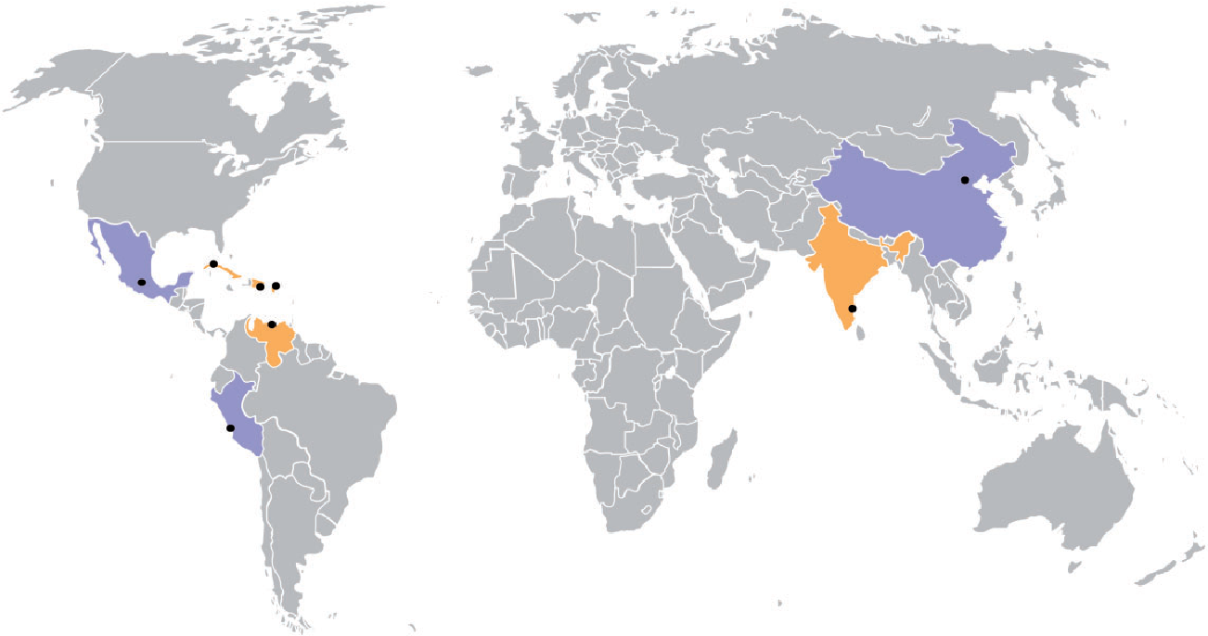
10/66 cohort
▪ Prina, A. M., et al. (2016). Cohort profile: the 10/66 study. International journal of epidemiology, 46(2), 406-406i.

Slide 4
10/66 cohort
Individuals of 65+ years
Data available from ≈ 11,000 participants
Follow-up time between 3 – 5 years
Comprehensive interview that included information on:
Household;
Socio-demographic;
Health status;
Physical and neurological examination.
Dementia diagnosed according to:
DSM-IV criteria
10/66 dementia diagnosis algorithm
Community Screening Instrument of Dementia (CSI-D)
CERAD modified 10 world list recall
Geriatric Mental State (GMS)

Slide 5
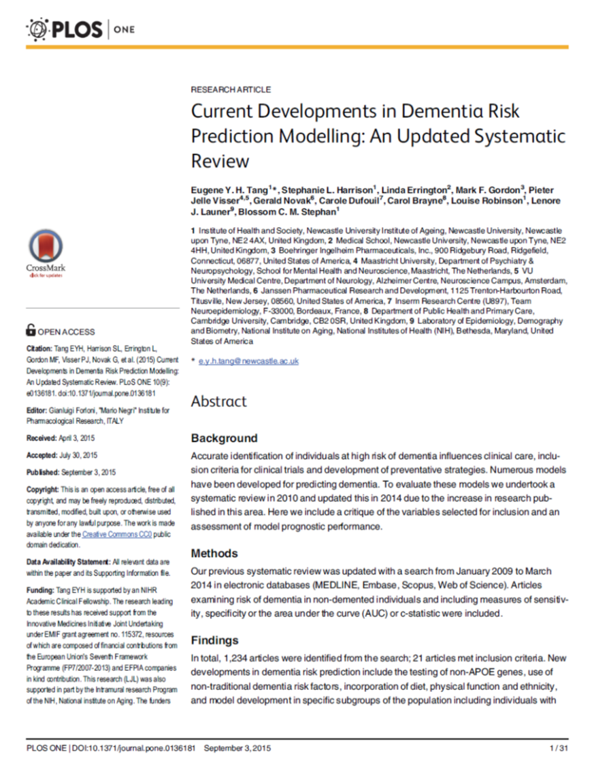
Dementia risk prediction models
Dementia risk prediction models were selected from a recent systematic review undertaken by members of the study team.
Only those models where identical or near similar predictor variables were selected for mapping.
In total, 13 models incorporating 29 different variables were selected, including variables related to:
Demographic
Lifestyle
Diet
Health and disease
Difficulties in daily life (e.g. ADL / IADL)
Neuropsychological test performance
▪ Tang, E. Y., et al. (2015). Current developments in dementia risk prediction modelling: an updated systematic review. PLoS One, 10(9), e0136181.

Slide 6
Statistical methods
Each model was mapped in the baseline sample.
Model external validation was tested using Competing Risks Regression, which takes into account the competing risk of death (i.e. dementia – free death), based on the Fine and Gray sub-distribution hazard method.
Predictive accuracy was tested using the uncensored Harrell’s C statistic with 95% confidence intervals (95%CI).
Two sets of analysis were conducted with each model run in:
(1) the complete dataset;
(2) in each of the seven countries separately.
Notes:
consider c-statistic values of 0.8–1, 0.7–0.8 and <0.7 to indicate excellent models, good models and models of questionable utility, respectively.

Slide 7
Dementia risk prediction models
 | Original model |  |  |  |  |  |  | Mapping in the 10/66 dataset
 | Author, year | Country | Sample size | Age at baseline | Follow-up | Outcome | Variables | Variables
1 | Verhaaren, 2013 | NL | 5507 | 45 - 99 years | 10 years | Alzheimer | ▫ Age ▫ Gender | ▫ Age ▫ Gender
2 | Anstey, 2014 | (1) USA (2) Sweden (3) USA | (1) 2496 (2) 905 (3) 903 | (1) ≥ 62 years (2) ≥ 74 years (3) ≥ 54 years | (1) 3,5 years (2) 6 years (3) 6 years | Dementia | ANU-ADRI score of different variables: ▫ Age ▫ Gender ▫ Education ▫ Smoking status ▫ Alcohol intake ▫ Diabetes | ▫ Age ▫ Gender ▫ Education ▫ Smoking status ▫ Hazardous drinker ▫ Diabetes
3 | Kivipelto, 2006 | Finland | 1409 | 39 - 64 years | 20 years | Dementia | CAIDE score: ▫ Age ▫ Gender ▫ Education ▫ Physical activity ▫ BMI ▫ Systolic blood pressure ▫ Total cholesterol | ▫ Age ▫ Gender ▫ Education ▫ Physical activity ▫ Waist circumference ▫ Systolic blood pressure ▫ Total cholesterol
4 | Jorm, 2005 | Hawaii | 3734 | 71 - 93 years | 3 - 6 years | Dementia | ▫ Age ▫ Education ▫ CASI episodic memory ▫ CASI visual construction ▫ Subjective memory impairment | ▫ Age ▫ Education ▫ World list learning ▫ Copy circle correct; copy pentagon correct ▫ Subjective memory impairment
Notes:
Explain: as this is first study, no scores added, but only looked if these type of variables work in LMIC cohort

Slide 8
Harrell’s C statistic and 95%CI for dementia risk prediction models
Original:
0.79 (0.77 – 0.81), n=5,507
10 / 66:
0.69 (0.68 – 0.71), n=11,131.
Original:
0.72 (0.70 – 0.75), n=2,496
0.68 (0.64 – 0.71), n=905
0.68 (0.64 – 0.72), n=903
10 / 66:
0.70 (0.68 – 0.72), n=10,470.
Original:
0.77 (0.71 – 0.83), n=1,409
10 / 66:
0.71 (0.69 – 0.73), n=6,659
Original:
0.73 (0.66 – 0.80), n=3,734
10 / 66:
0.74 (0.72 – 0.75), n=11,067

Slide 9
Harrell’s C statistic and 95%CI for dementia risk prediction models
DR: 0.67 (0.62 - 0.71), n=1,439
Peru: 0.79 (0.73 - 0.84), n=1,323
DR: 0.67 (0.63 - 0.71), n=1,424
Peru: 0.82 (0.77 - 0.86), n=1,280
DR: 0.70 (0.66 - 0.75), n=1,075
Peru: 0.80 (0.72 - 0.89), n=555
DR: 0.71 (0.67 - 0.74), n=1,434
Peru: 0.85 (0.81 - 0.89), n=1,309

Slide 10
Harrell’s C statistic and 95%CI for dementia risk prediction models
China: 0.70 (0.66 - 0.73), n=1,832
China: 0.70 (0.67 - 0.74), n=1,831
China: n=0
China: 0.71 (0.68 - 0.75), n=1,818

Slide 11
Cohort characteristics
 | Complete 10/66 dataset | Dominican Republic | Peru | China
Sample size | 13,483 | 1,441 | 1,323 | 1,832
Median follow-up time | 4 years | 5 years | 3 years | 5 years
Dementia at follow-up, n (%) | 1,069 (10%) | 165 (12%) | 77 (6%) | 207 (11%)
Deceased at follow-up, n (%) | 1,709 (15%) | 323 (22%) | 101 (8%) | 380 (21%)

Slide 12
Conclusion (1)
Some dementia risk prediction models developed in HIC appear to translate well in LMICs. Namely those models that incorporate demographic and cognitive performance variables, however, large, unexplained, variety in discriminative accuracy is seen between LMICs.

Slide 13
Conclusion (2)
In addition, model incorporating lifestyle and disease related variables does not seem to substantially improve the discriminative performance of dementia models in comparison to a model based on only age.

Slide 14
Conclusion (3)
Future studies are needed to identify if other factors, than identified in HIC cohorts, are highly predictive for the risk of developing dementia in elderly from LMICs.
In addition, future studies need to identify which neuropsychological tests results are best performing in dementia risk prediction models.
Focus should be on the feasibility of the dementia risk prediction model in LMICs.

Slide 15
This research was commissioned by the National Institute of Health Research using Official Developed Assistance (ODA) funding. The views expressed in this publication are those of the authors and not necessarily those of the NHS, the National Institute of Health Research or the Department of Health.
Sponsor and grant number: GHR Group: 16/137/62 – NIHR Global Health Research Group on Dementia Prevention and Enhanced Care (DePEC), Newcastle University.

